Slide 1
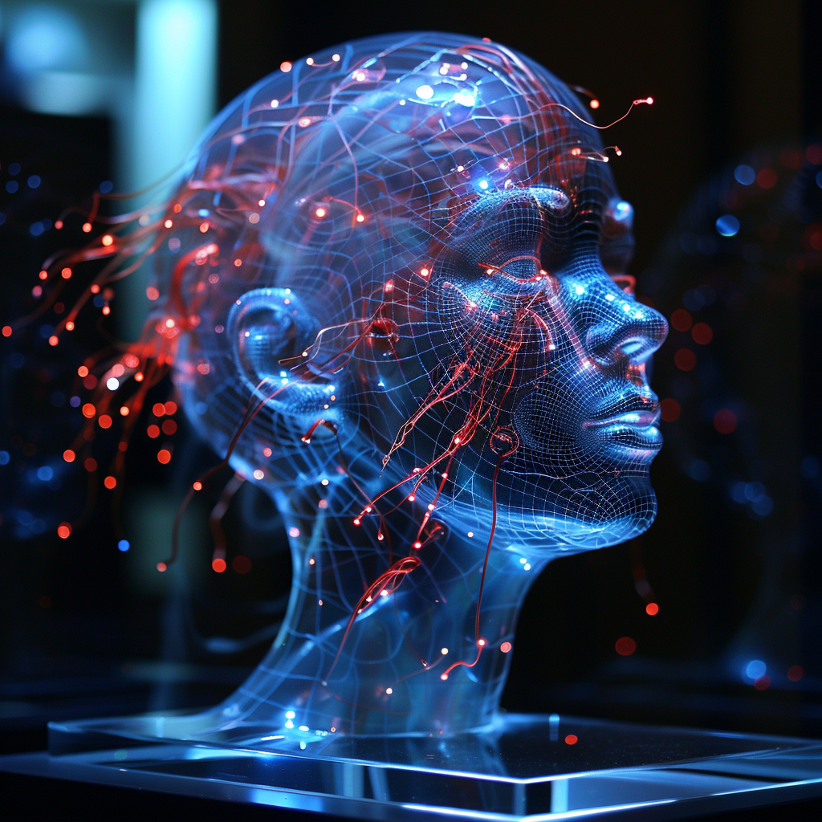
Neuroscience and Brain-Computer Interfaces (BCIs):
How Libraries Can Use the Technology
Photo credit: Chad Mairn/Midjourney

Slide 2
Agenda:
Understand the basics of neuroscience and BCI’s,
Learn about the latest developments in BCI technology,
Explore how BCI’s can treat neurological disorders and help people with disabilities, and
Discuss how libraries can use BCI technology to improve the user experience.

Slide 3
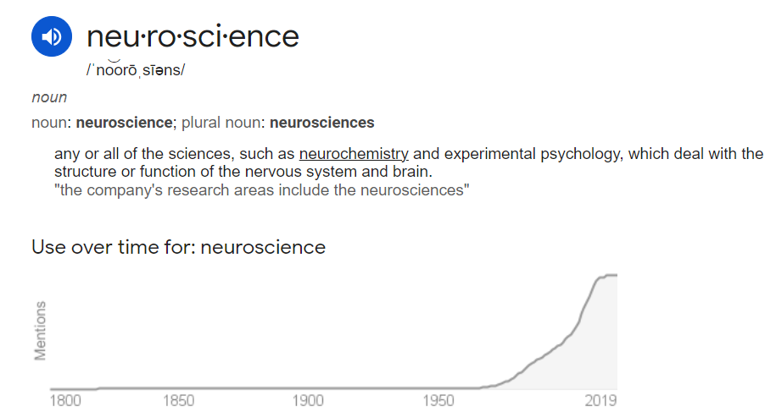
Source

Slide 5
https://neurotorium.org

Slide 6
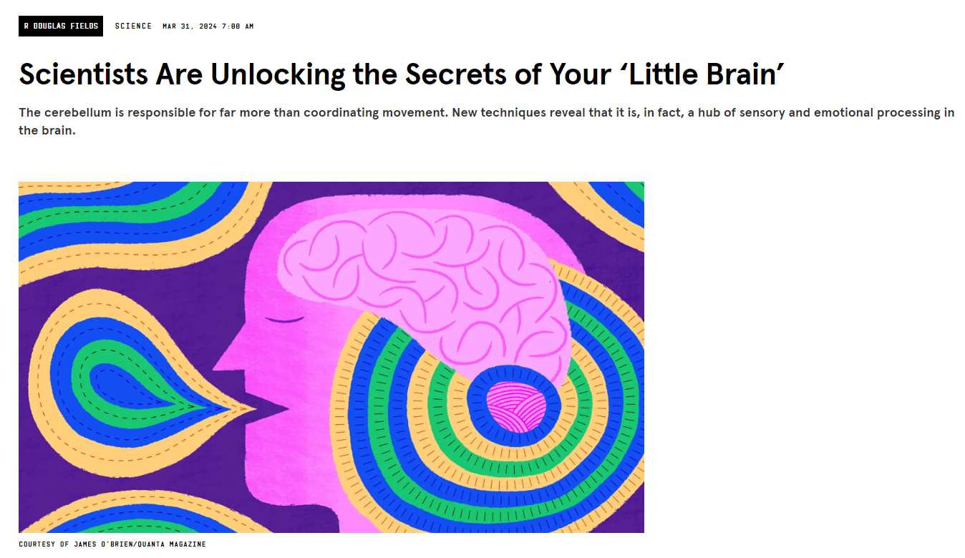
Source

Slide 7
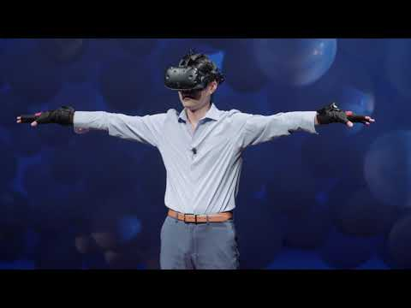
VR activates the motor cortex in our sensory system

Slide 8
Brain–computer interface (BCI):
A direct communication pathway between the brain's electrical activity and an external device.
Research on BCIs began in the 1970s by Jacques Vidal at the University of California, Los Angeles (UCLA)
Implementations of BCIs range from non-invasive (EEG, MEG, MRI) to invasive (microelectrode array)
Source

Slide 9
https://neuralink.com
Their mission is to “create a generalized brain interface to restore autonomy to those with unmet medical needs today and unlock human potential tomorrow.”

Slide 10
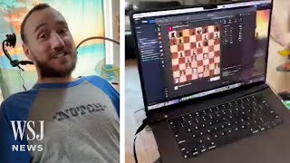
Neuralink’s First Patient Play Chess Using Brain Implant
Wired story

Slide 11
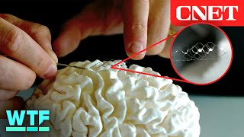
Brain-Computer Interface: No Open Brain Surgery Required

Slide 12
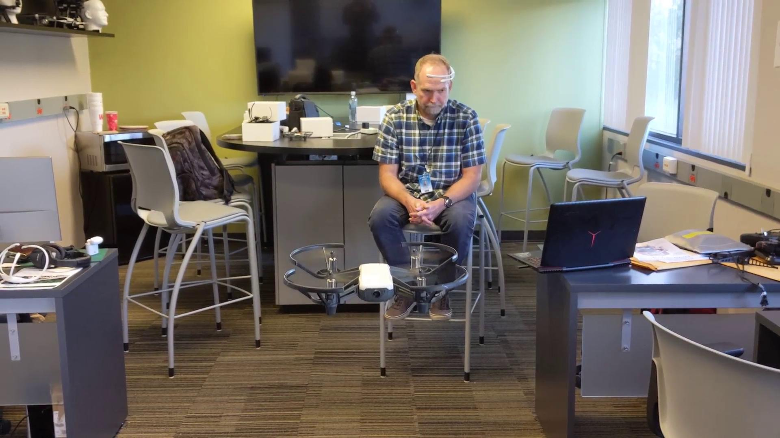

Slide 13
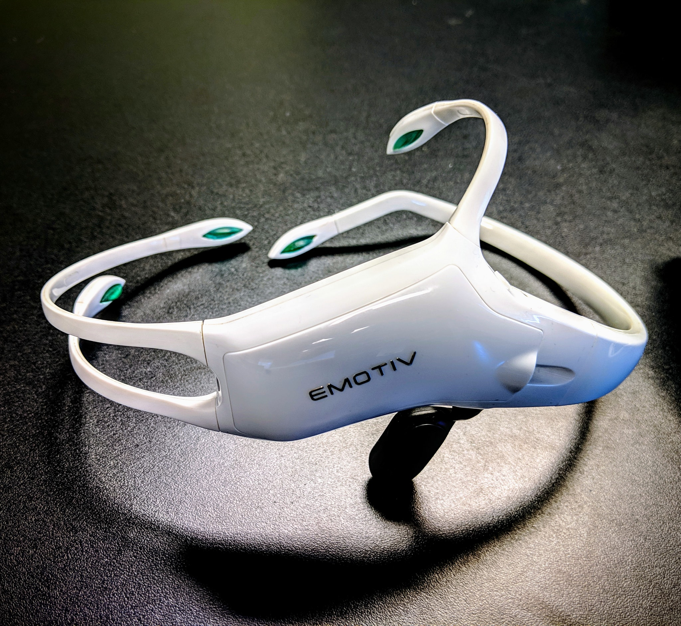

Slide 14
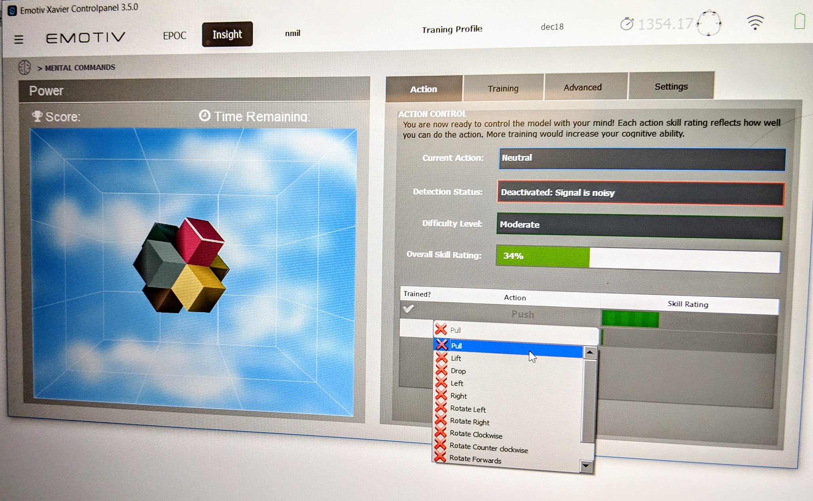

Slide 15
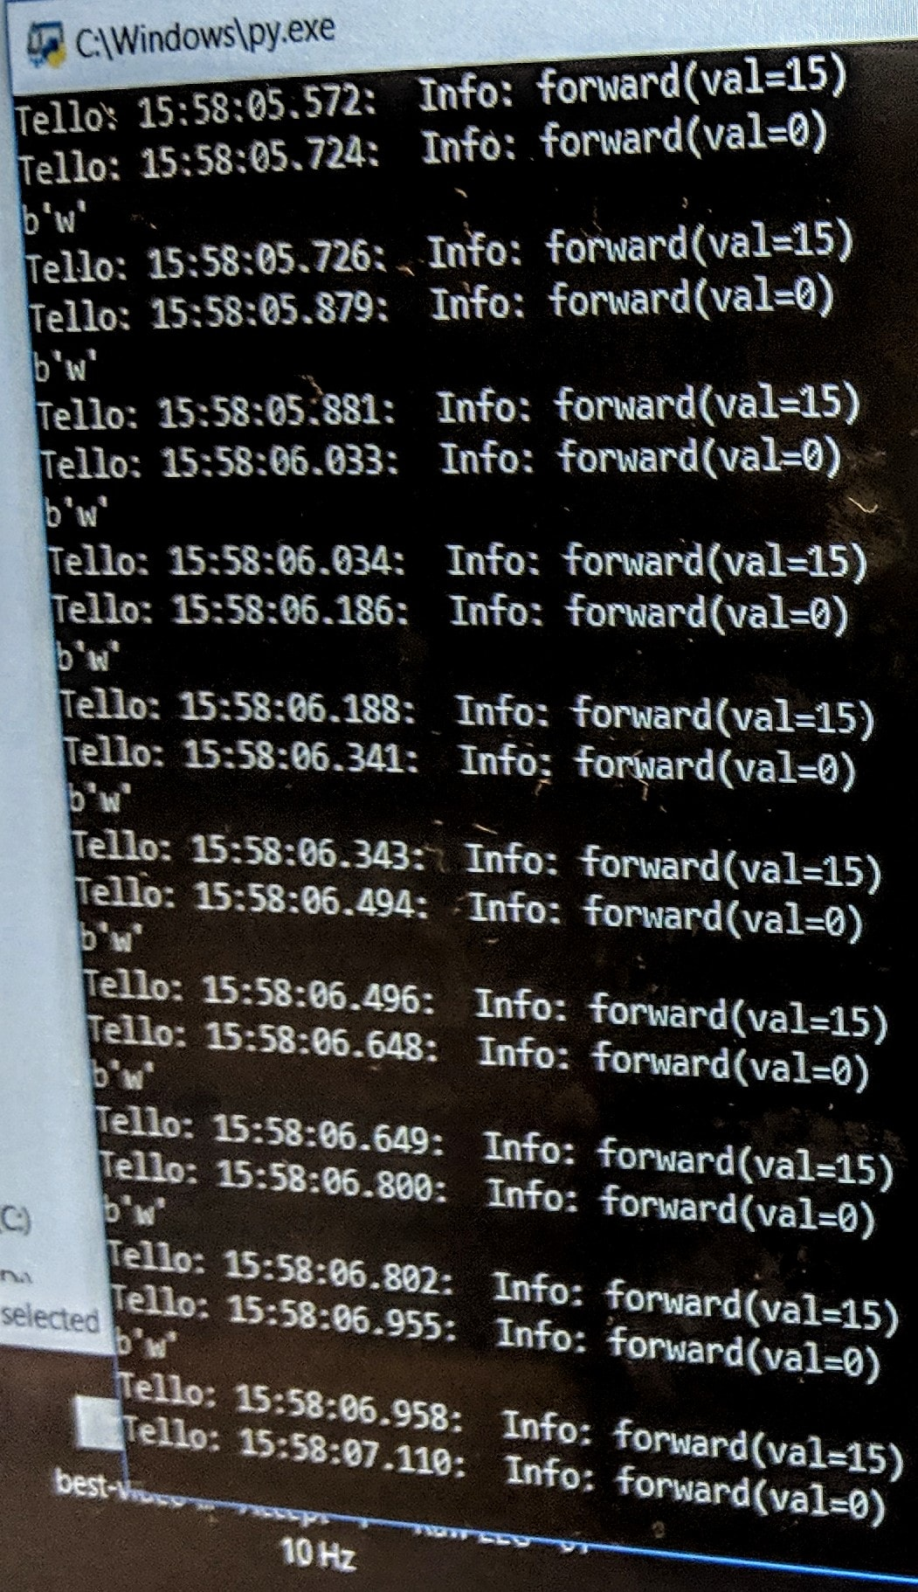
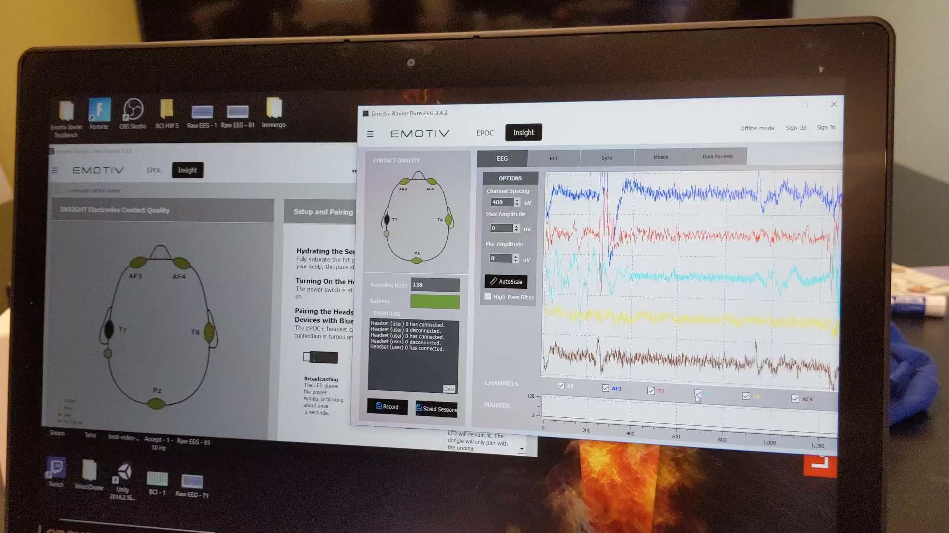

Slide 16
The Thought-Reading Machine by Andre Maurois first introduced BCI’s in this 1938 novel.
Source

Slide 17
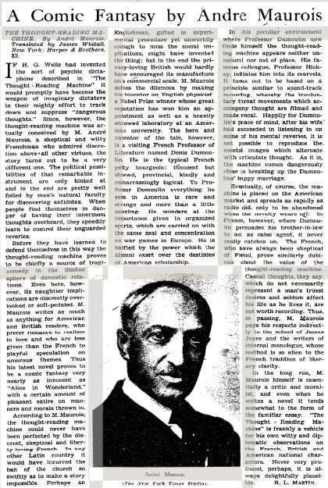
If H. G. Wells had invented the sort of psychic dictaphone described in "The Thought-Reading Machine" it would promptly have become the weapon of imaginary dictators in their mighty effort to track down and suppress "dangerous thoughts."
New York Times, May 29, 1938
Review by R. L. MARTIN.
Source

Slide 18
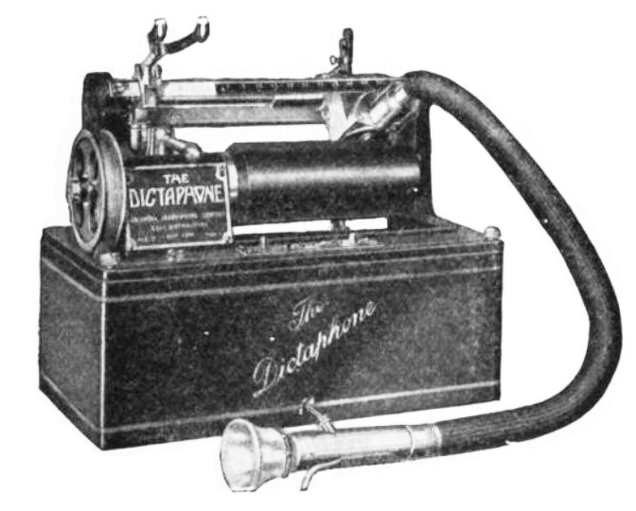
The Dictaphone was trademarked in 1907 by the Columbia Graphophone Company and was used for dictation.

Slide 19
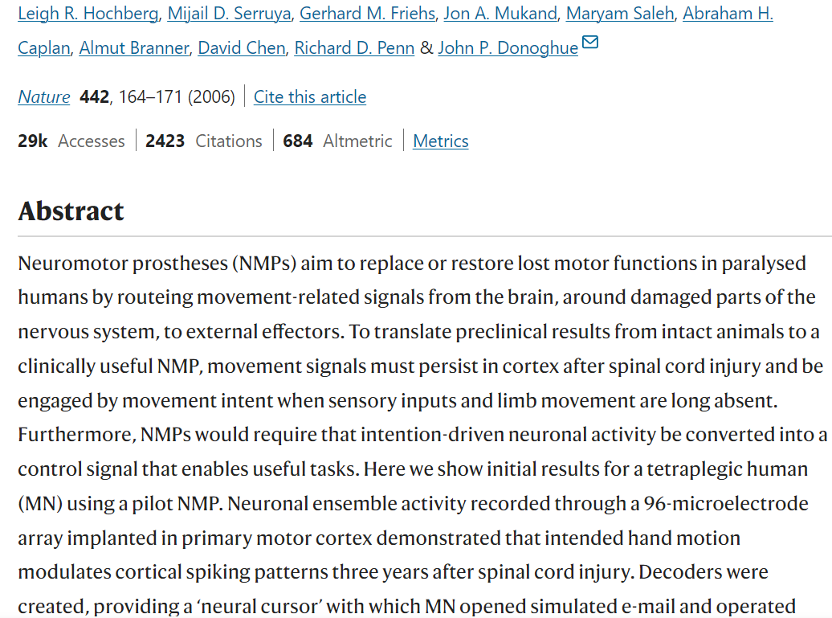
Neuronal ensemble control of prosthetic devices by a human with tetraplegia
Editorial Summary Turning thoughts into actions
Matt Nagle is unable to move his arms or legs following cervical spinal cord injury. Researchers at the Department of Neuroscience at Brown University, working with biotech company Cyberkinetics and 3 other institutions, demonstrate that movement-related signals can be relayed from the brain via an implanted BrainGate chip, allowing the patient to drive a computer screen cursor and activate simple robotic devices. Such neuromotor prostheses could pave the way towards systems to replace or restore lost motor function in paralysed humans. Prior to this advance, this type of work has been performed chiefly in monkeys. The latest example of such research has achieved a large increase in speed over current devices, enhancing the prospects for clinically viable brain-machine interfaces.

Slide 20
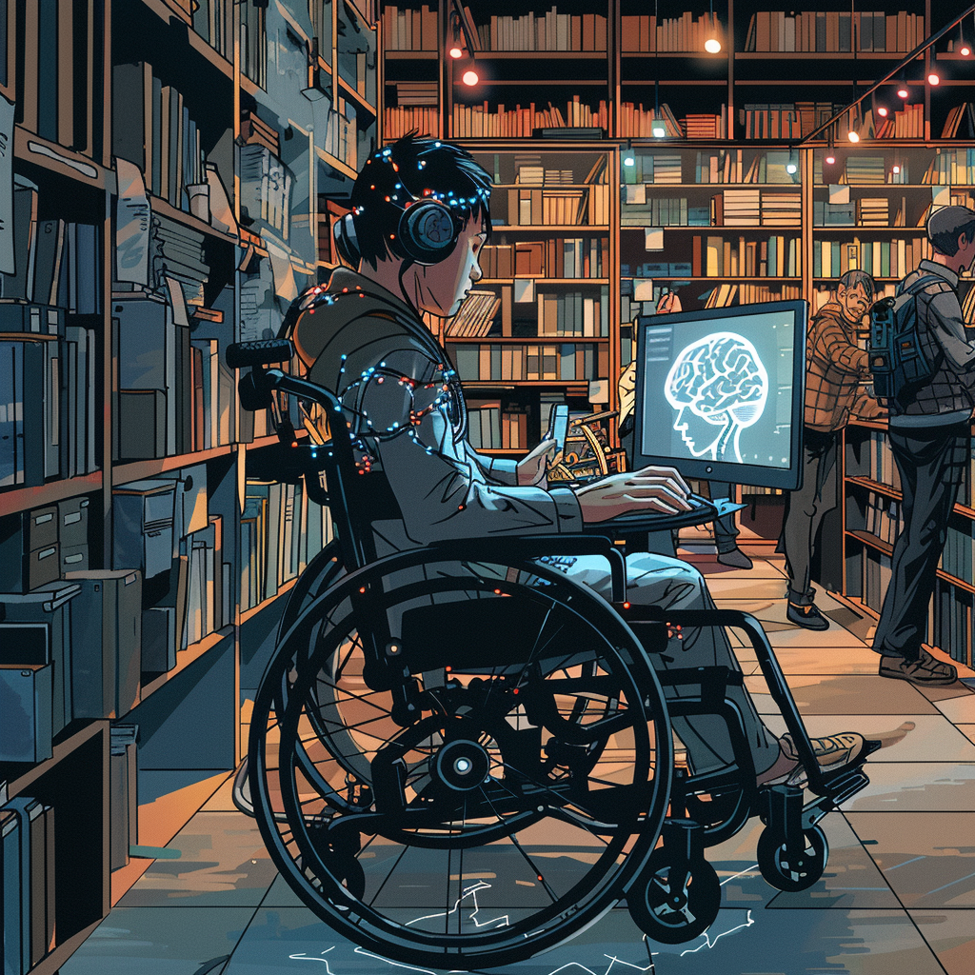
BCIs could help make libraries more accessible by allowing library users with physical disabilities a way to interact with and control library systems and services using only their brain activity, bypassing the need for physical input devices.
Photo credit: Chad Mairn/Midjourney

Slide 21
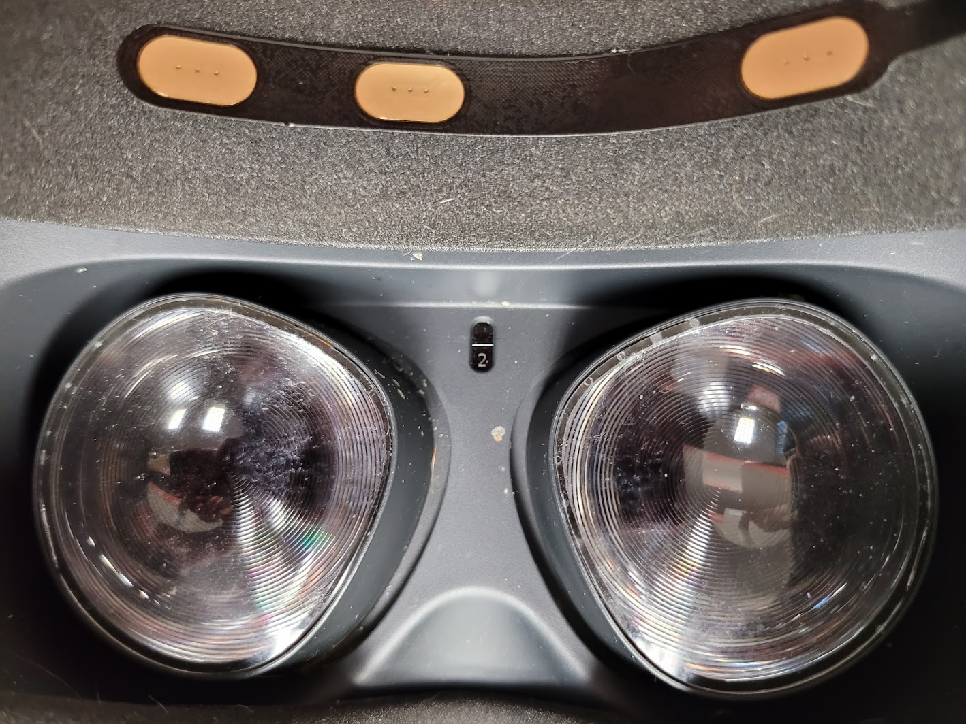
MyndPlay application to sync with the EEG Inside VR

Slide 22
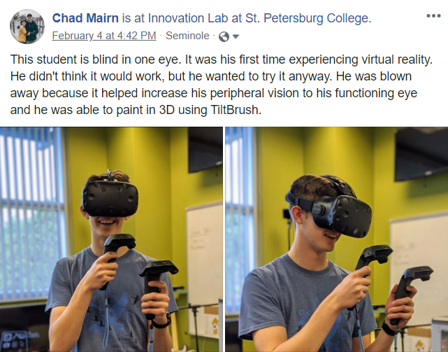

Slide 23
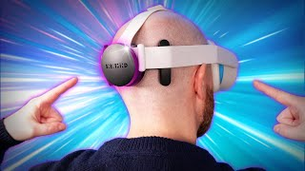
VR Mind Control

Slide 24
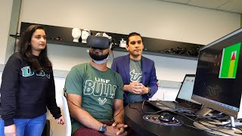
New brain painting method developed at USF being tested for ADHD treatment

Slide 25
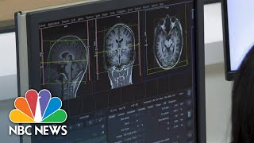
AI technology may be able to generate our mind’s images

Slide 26
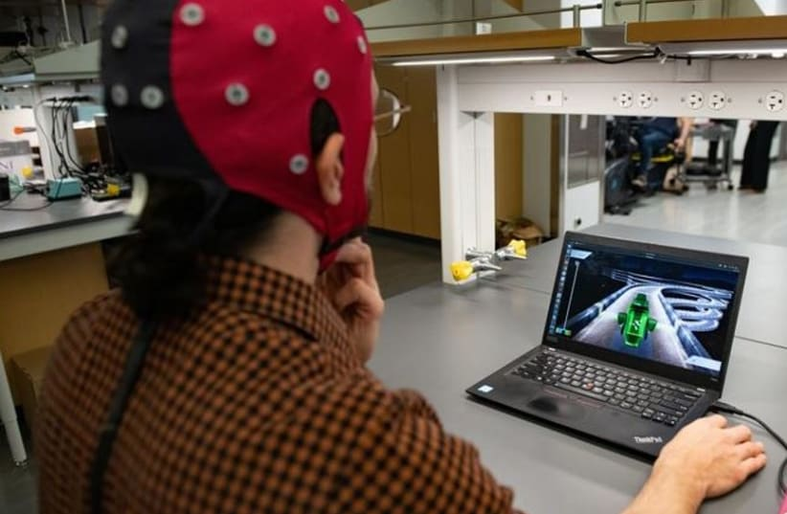
New brain-computer interface allows people to play games with their thoughts
source

Slide 27
Contact me
Mairn.Chad@spcollege.edu
(727) 394-6917
Photo credit: Chad Mairn/Midjourney

