Slide 1
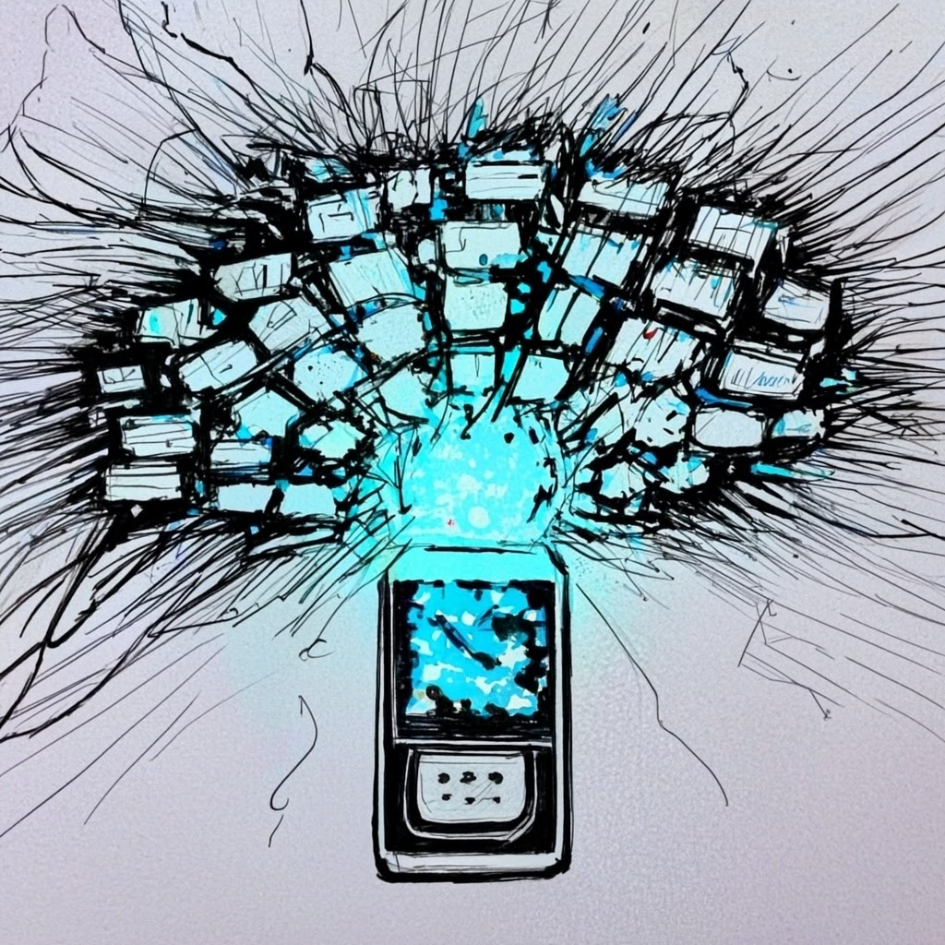
Exploring the Magic of IFTTT to Help Streamline Your Digital Life

Slide 2
Agenda
Understand the Internet of Things and see how they will change the world.
Learn how to use and customize IFTTT to connect with a variety of products and services.
Explore other automation tools like Zapier, Hootsuite, Buffer, and others.
Gain access to resources to help you become more efficient online.

Slide 3
Source: Google.com

Slide 5
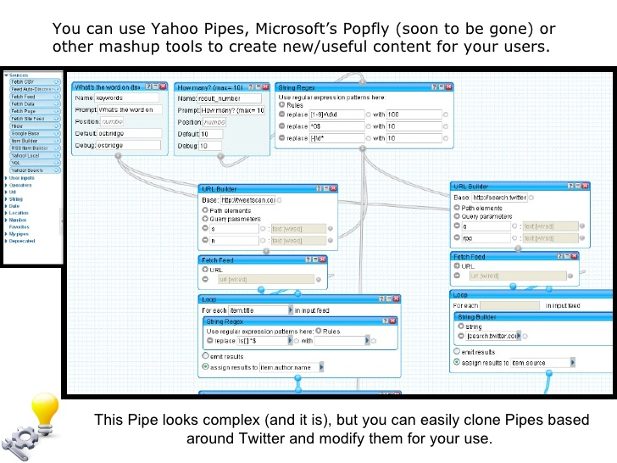
A blast from the past …

Slide 6
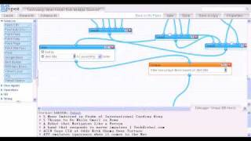
Using Yahoo! Pipes
Note: This pipe was recorded to show how to truncate each RSS feed to only 5 items, use the Union Module to merge 5 separate sources into a single list of items, sort them by title, and use the Unique Module to remove duplicate items.

Slide 7
Source
Yahoo Pipes Alternatives
Pipe2Py
RSS Percolator
Superpipes
FeedsAPI
Pypes
ClickScript
WebHookIt
Mulesoft
Quadrigram
Feedly + IFTTT solution
Huginn
Many of these are discontinued!

Slide 9
The Internet of Things is Far Bigger Than Anyone Realizes!
Source

Slide 10
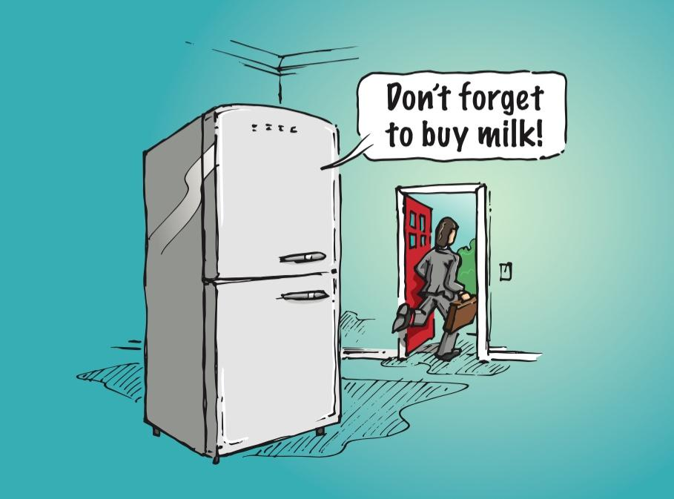
Source

Slide 11
Smart cement can monitor stress, contamination levels, cracks, fluid loss, and temperatures to determine how these factors change over time.
Source

Slide 12
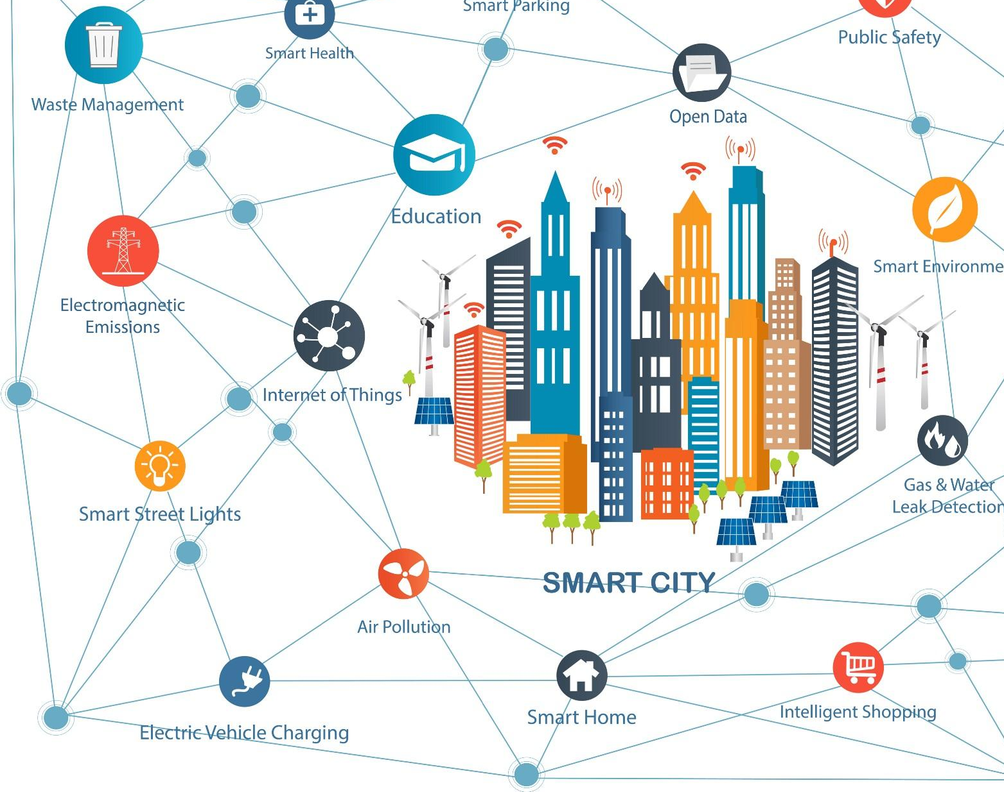
A Smart City uses Internet of things (IoT) sensors and other technologies to collect data to generate intelligence to help manage assets, resources, and services; increase operational efficiency; share information with the public; and to improve the quality of government services and citizen welfare.
Source

Slide 13
From Normal to Smart City
Early on, data may be stored, analyzed and used by city officials to do the “right thing” based off the data; however, in the long term, some of this stored data may be sold to cloud providers in other cities, that could transform a ‘normal’ city into a smart city quickly and with decreasing need for human involvement.
This Photo is licensed under CC BY-NC. Source

Slide 14
5G’s impact will be “similar to the introduction of electricity or the car, affecting entire economies and benefitting entire societies.” Steven Mollenkopf, the CEO Qualcomm
This Photo is licensed under CC BY-NC-ND

Slide 15
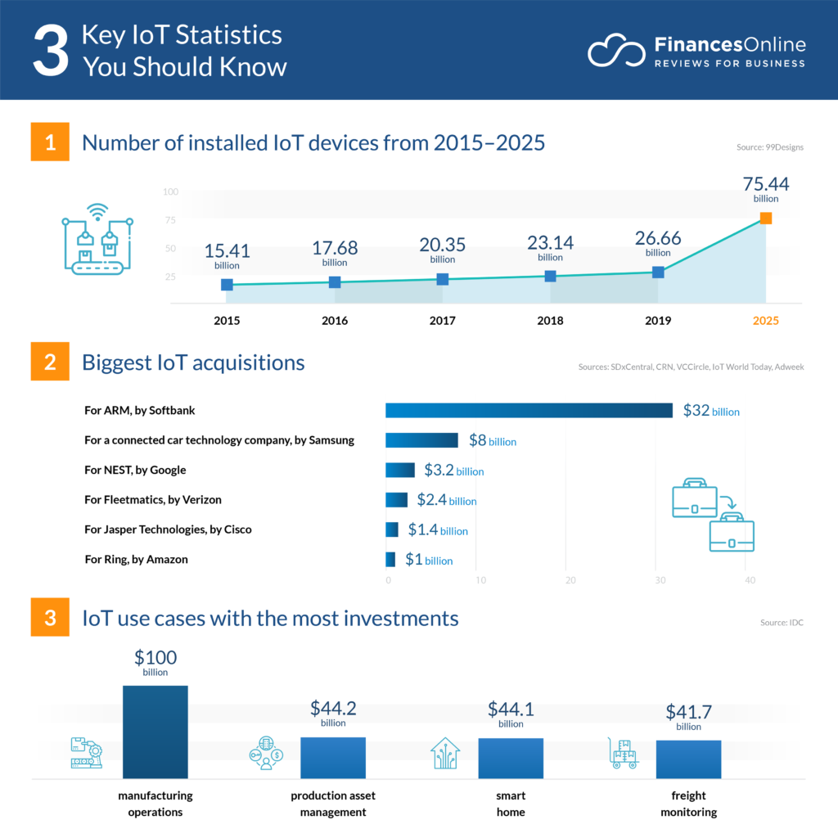
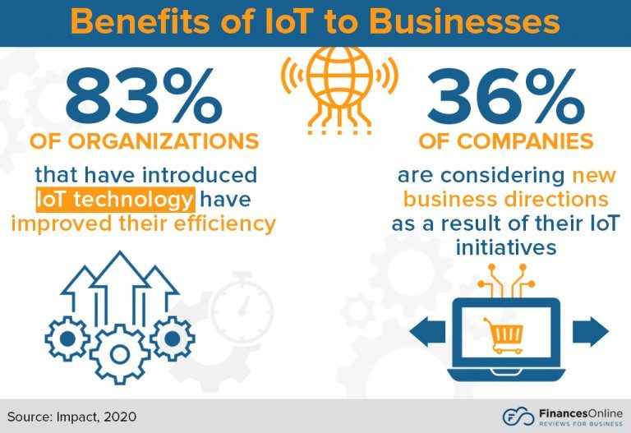
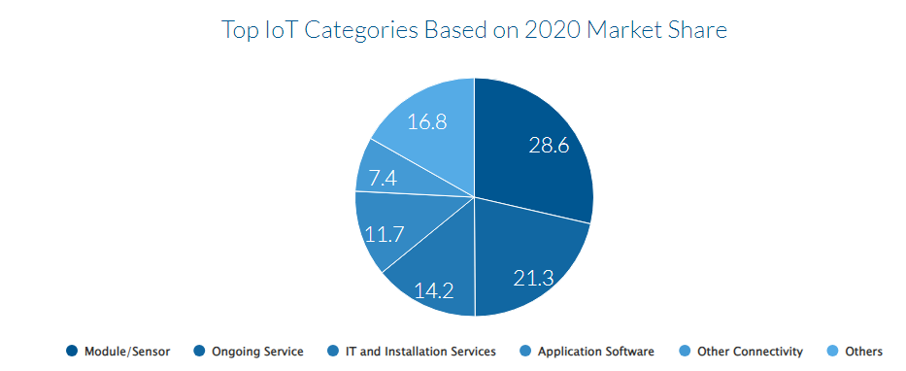
Source

Slide 16
IFTTT (If That Then This) 101
An action is the work that IFTTT initiates when a trigger fires.
A trigger is the data that, when changed, prompts an Applet to run on IFTTT.
An Applet connects two or more services together, enabling them to do things that they wouldn't be able to do alone.
Triggers and queries contain ingredients – individual pieces of data.
A query is a way to request additional data if the trigger doesn't provide it.
Services are the basic building blocks of IFTTT.

Slide 17
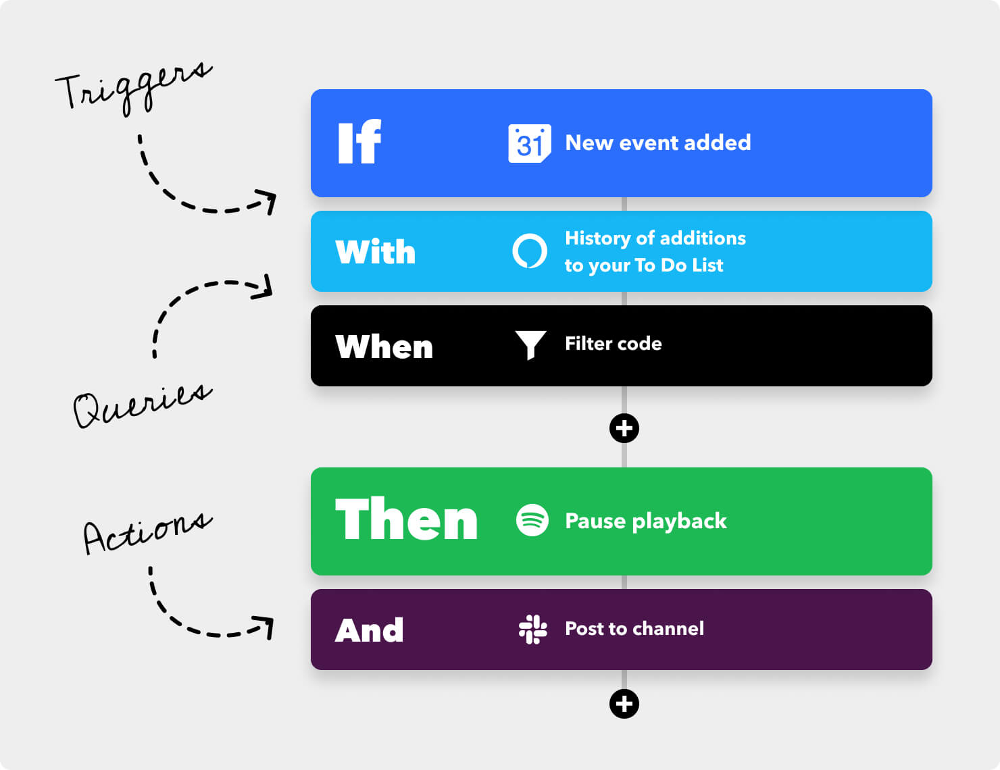

Slide 18
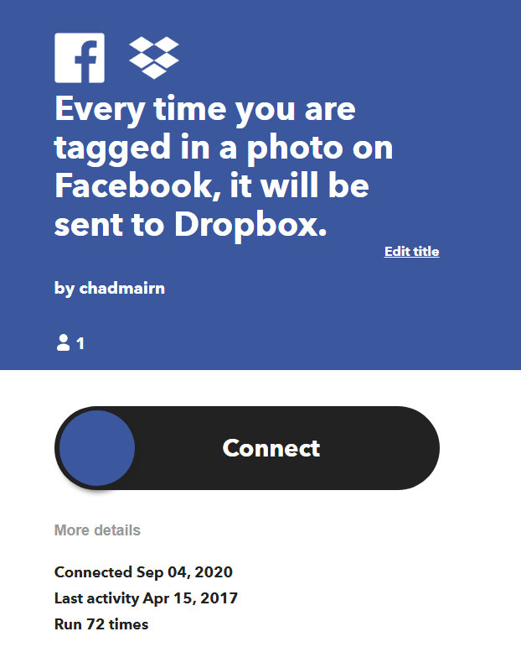
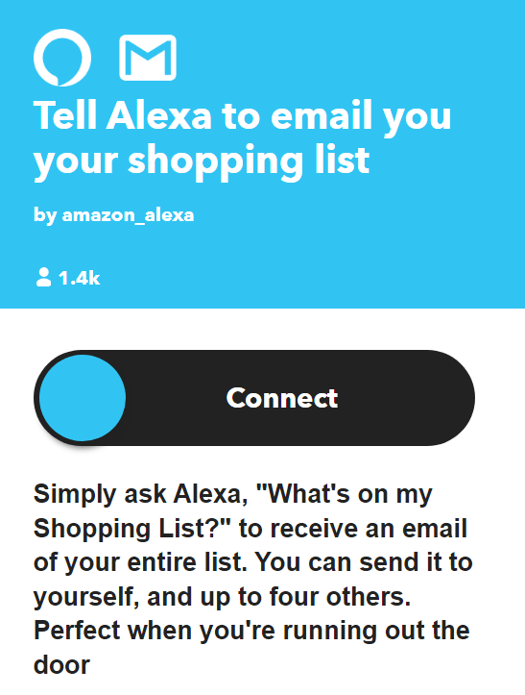

Slide 19
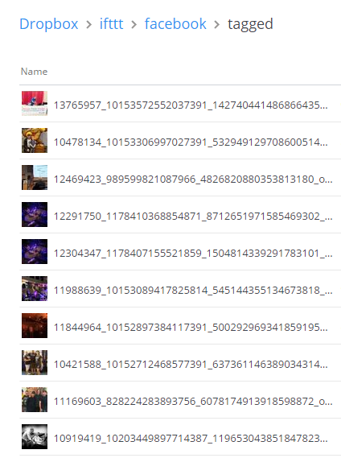
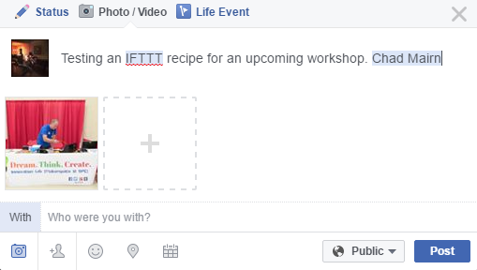
2.
1.

Slide 20
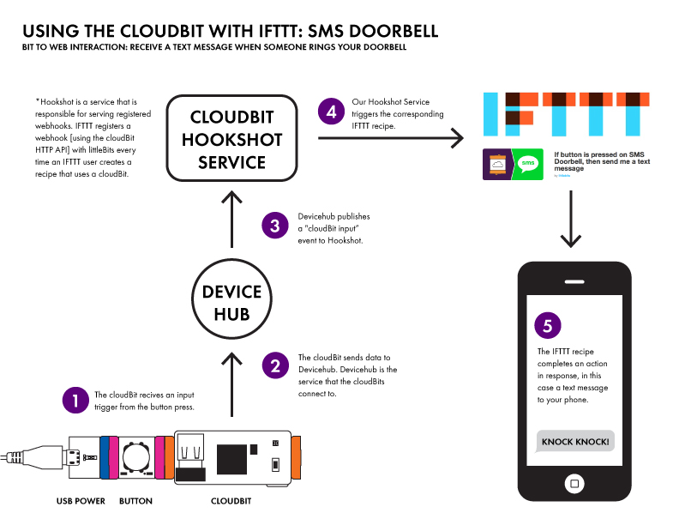

Slide 21
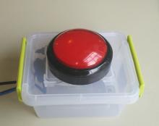
Simple Button to connect an Arduino to IFTTT
You can send an email, post to Facebook or Instagram, text a friend, or send a tweet with a single button!
Other Arduino and maker ideas

Slide 22
https://ifttt.com/maker

Slide 23
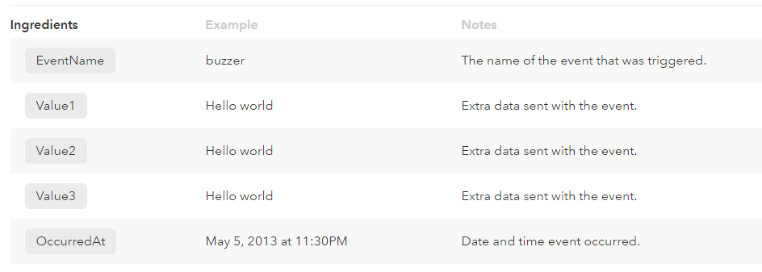
Receive a web request

Slide 24
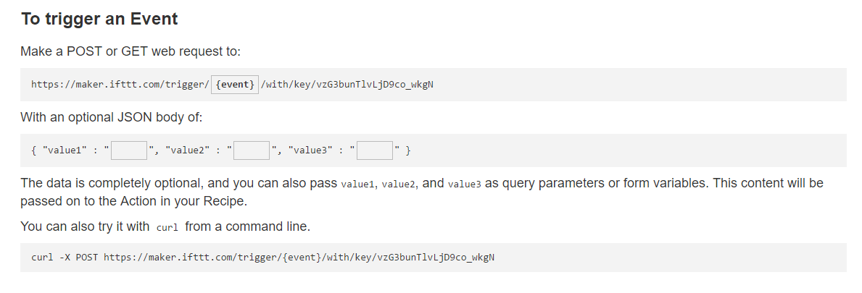
Make a web request
Shhh ... Be sure to keep your key a secret!
Arduino HTTP Requests: http://playground.arduino.cc/Code/WebClient
Python HTTP Requests (Raspberry Pi) http://www.python-requests.org/en/latest

Slide 25
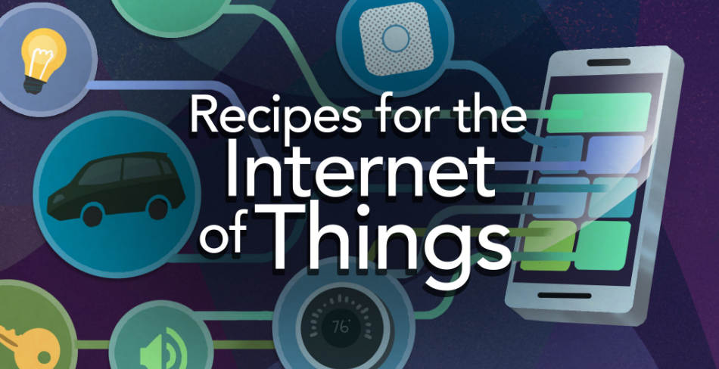
Let’s check some out!

Slide 26
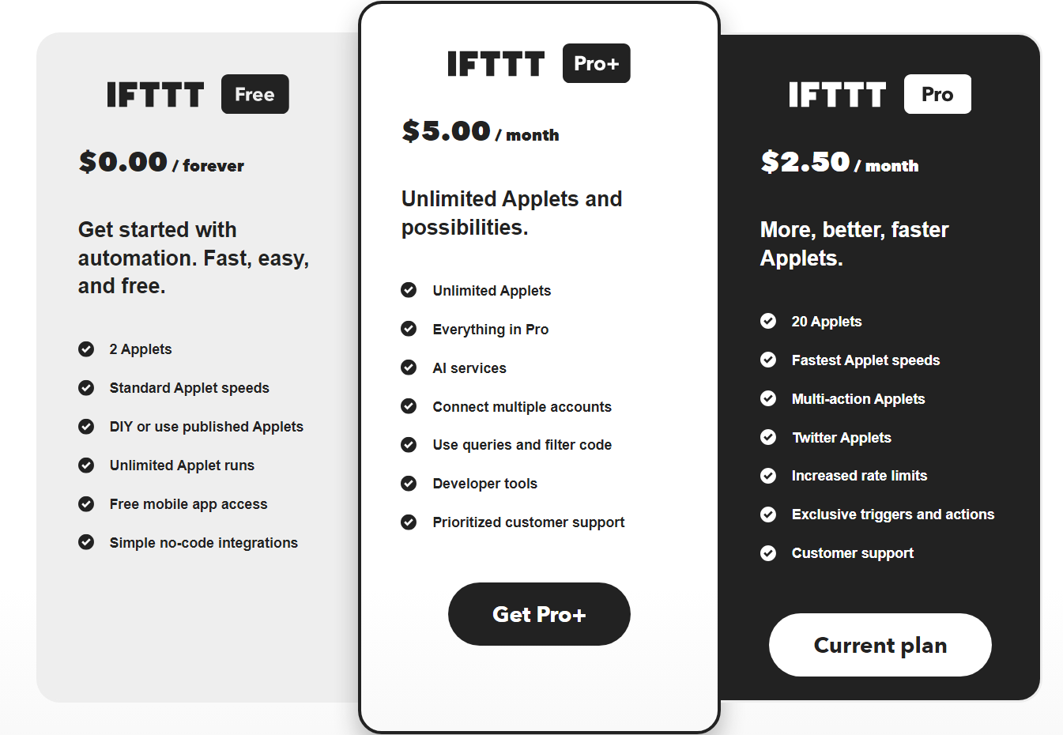
https://ifttt.com/subscriptions

Slide 27
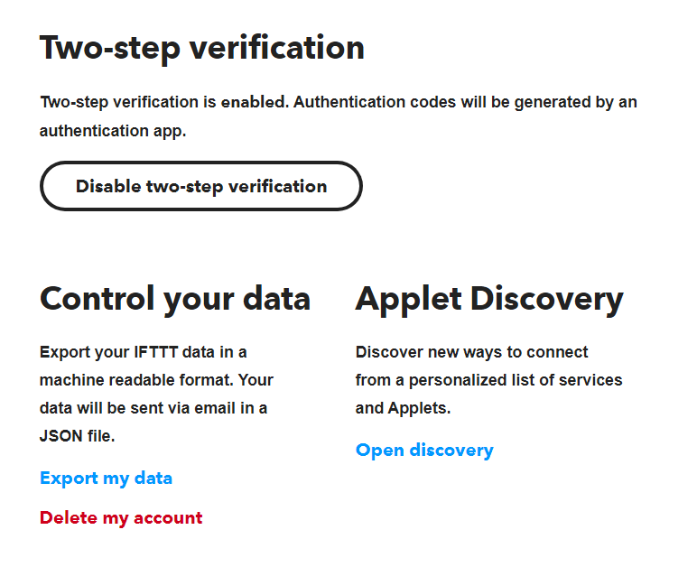
Google Authenticator

Slide 28
Create Applets on IFTTT

Slide 29
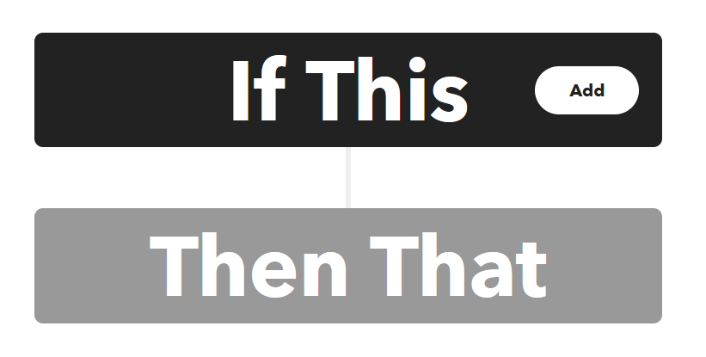
https://ifttt.com/create

Slide 30
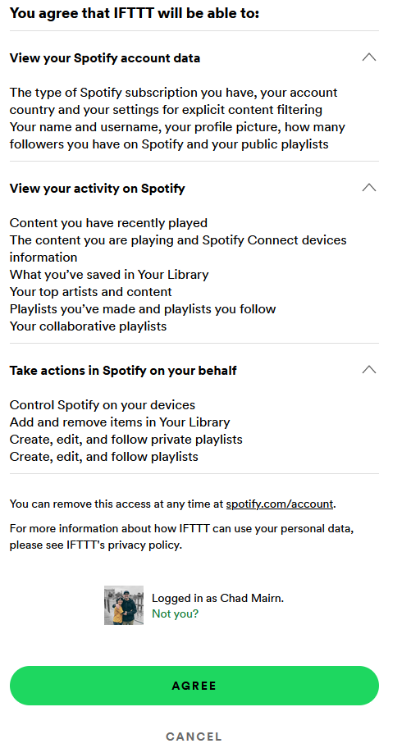
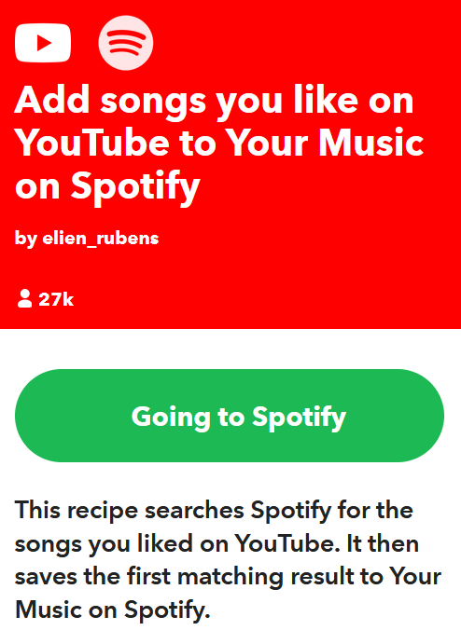
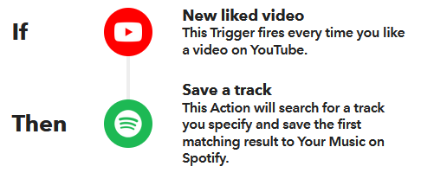
Open

Slide 31
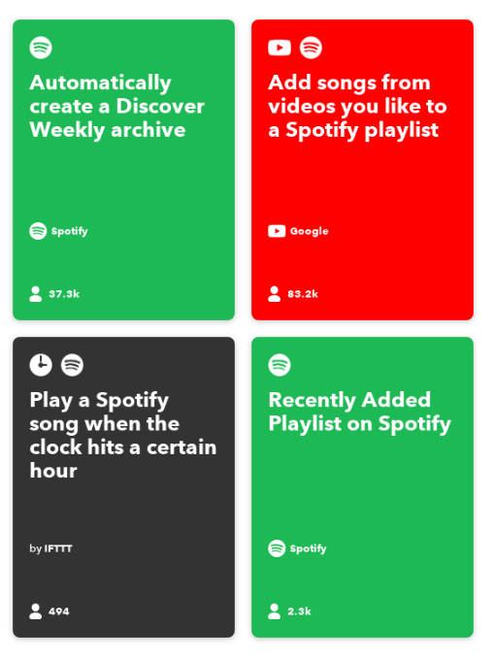
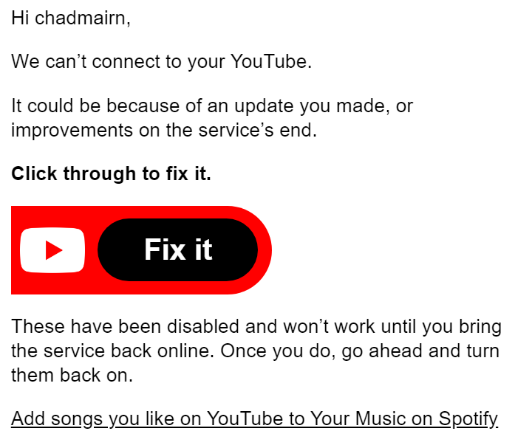

Slide 32
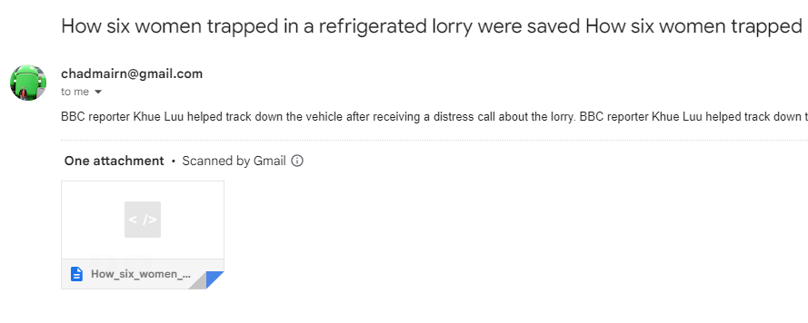
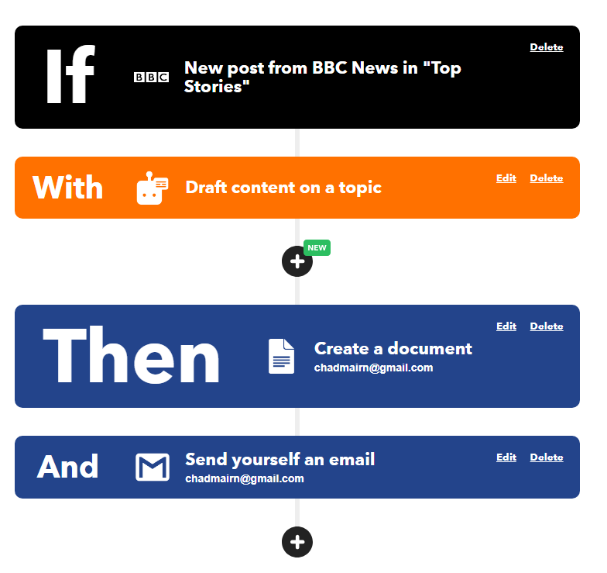
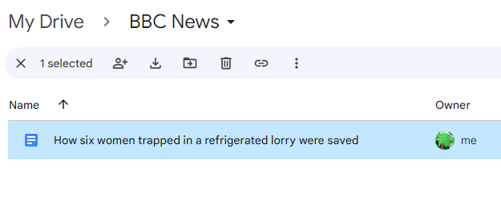

Slide 33
Now called Shortcuts
Download

Slide 34
Download

Slide 35
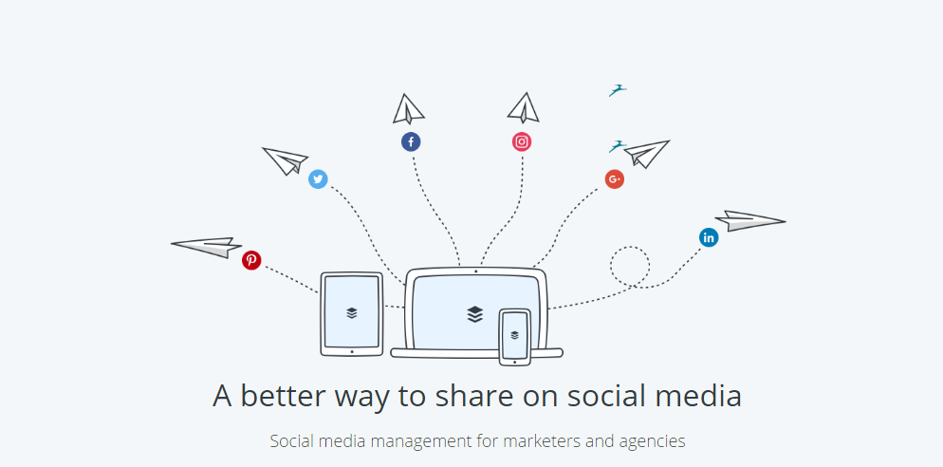
buffer.com

Slide 36
Manage multiple networks, schedule posts, and engage your audience, all in one place.
https://hootsuite.com/

Slide 37
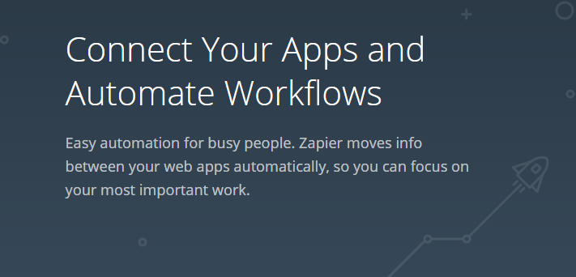
https://zapier.com/

Slide 38
Upload Zoom to YouTube Using Zapier

Slide 39
Contact me!

